Slide 1
Gobang 2077
Star Chen & William Zhang

Slide 2
Motivation
Game lovers.
A bit of competitivity and a bit of casualness.
The current chat system is still limited and boring.
TADA! A Gobang Game!

Slide 3
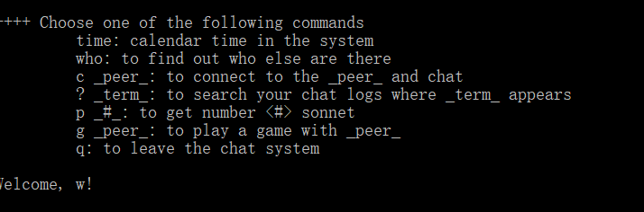
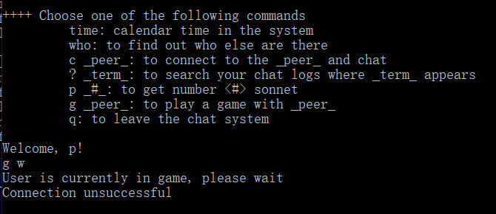
Structure of the App
g + peer name
Peer unavailable?
The server would show:

Slide 4
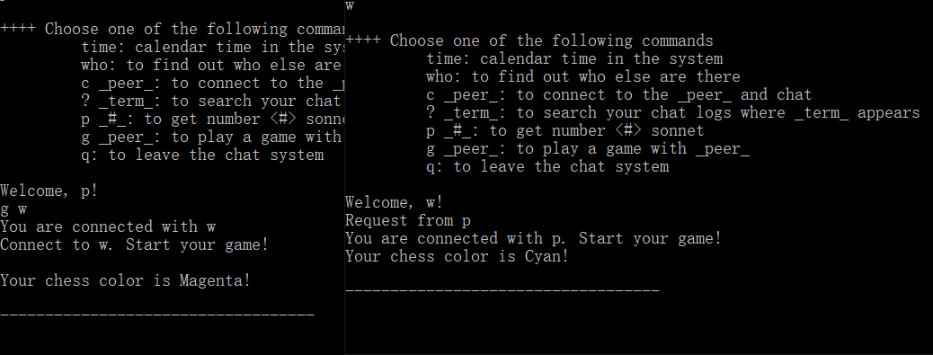
Structure of the App
the server would inform which color the user is assigned

Slide 5
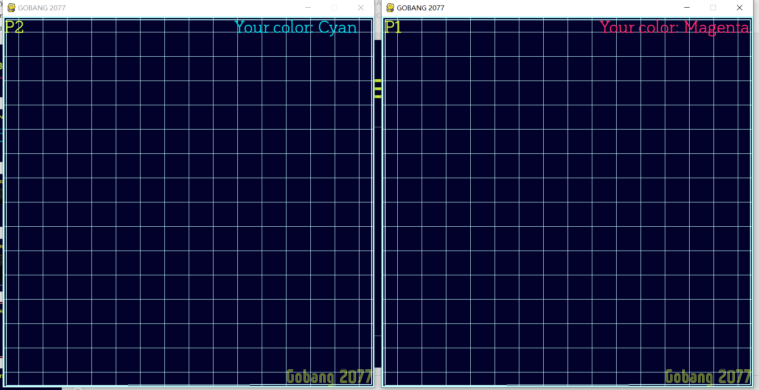
Structure of the App
Your Player Number
Your Color

Slide 6
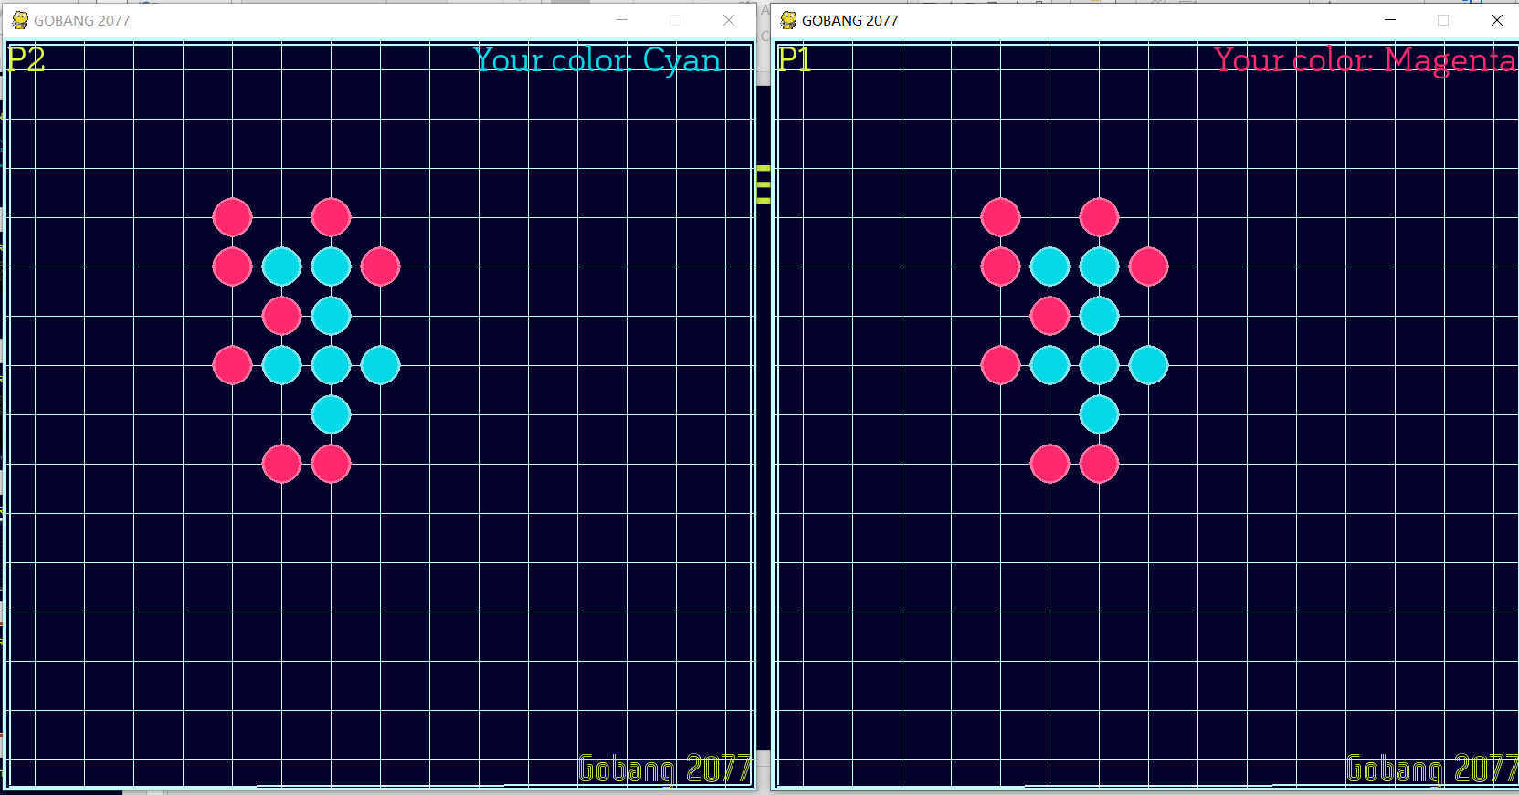
Structure of the App
Plays just like a traditional Gobang game!

Slide 7
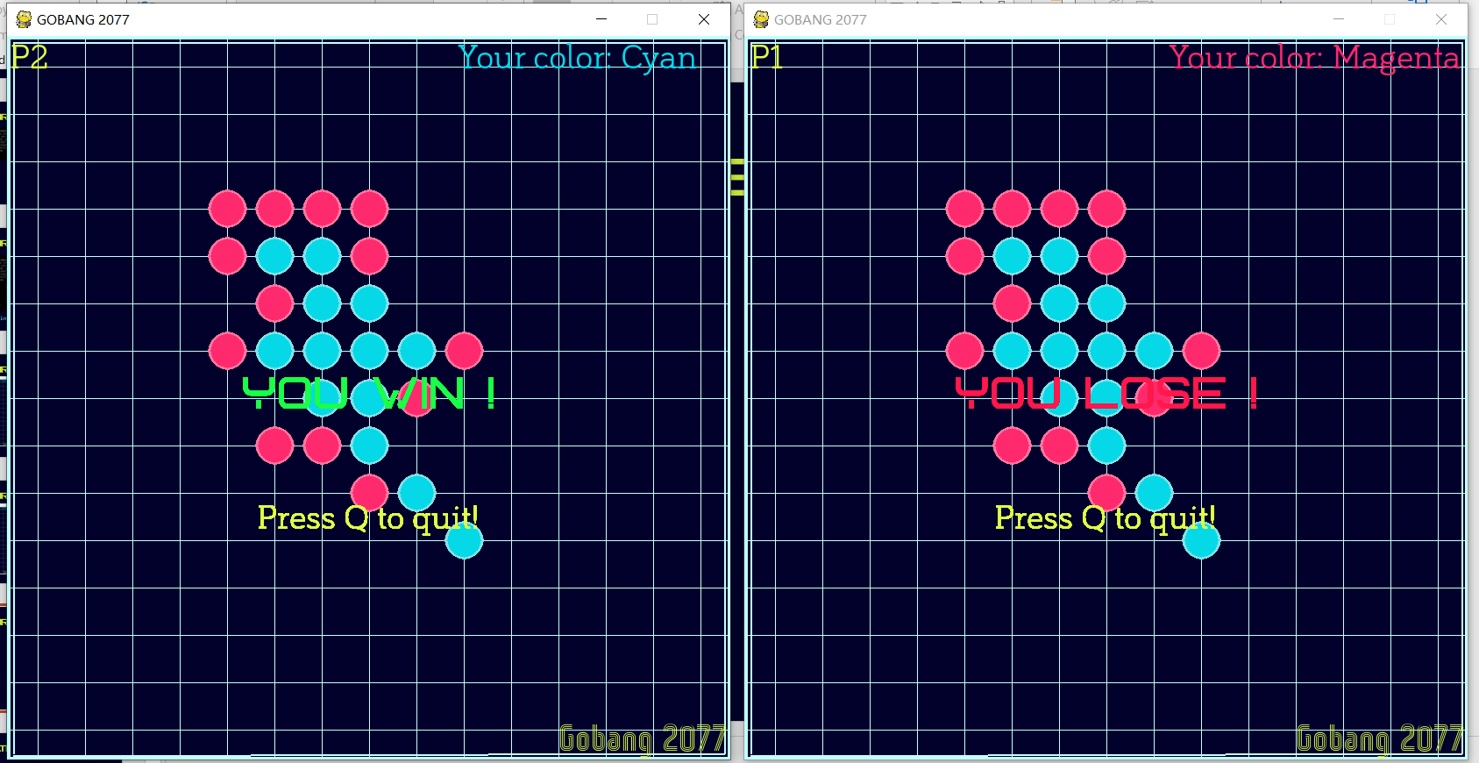
Structure of the App
On detecting winning….

Slide 8
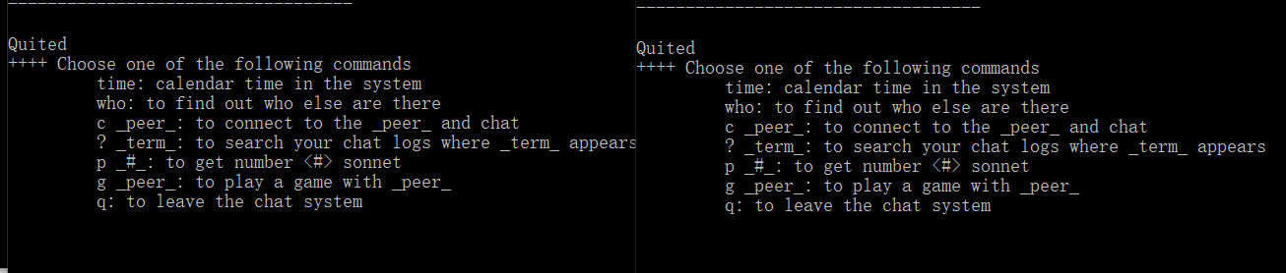
Structure of the App
On pressing ‘Q’, both of the user would quit and return to the main chat room.

Slide 9
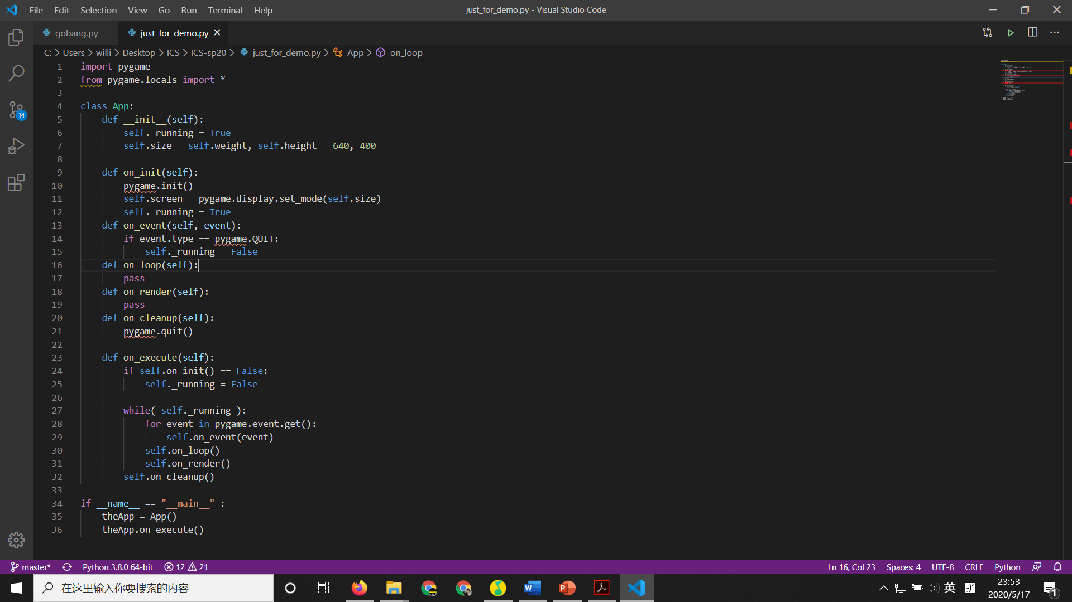
Explanation of approach
Utilize OOP

Slide 10
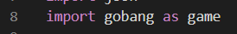
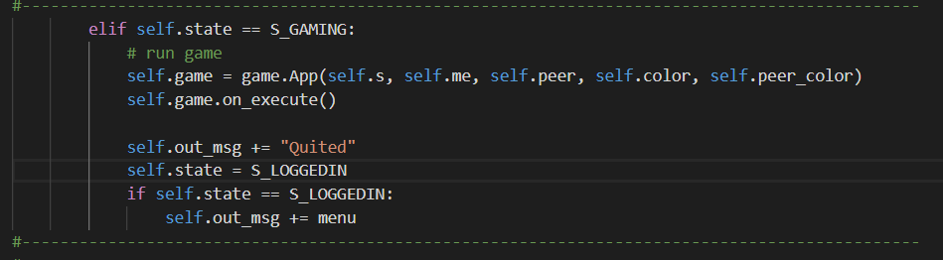
Explanation of approach
Import the game module into the client_state_machine.py

Slide 11
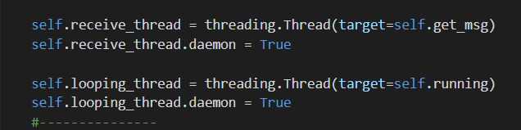
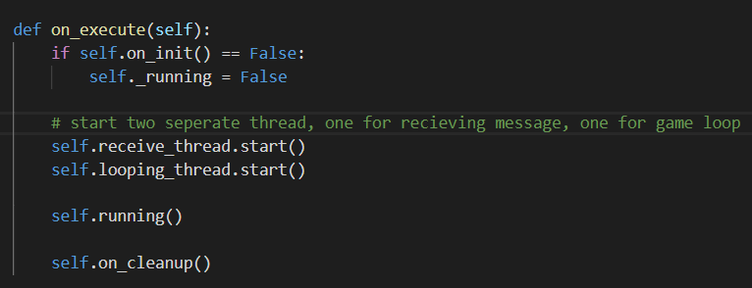
Explanation of approach
Server receive issue, conflict with game loop
– using threading

Slide 12
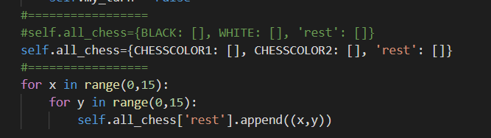
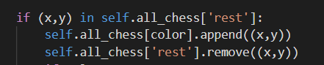
Explanation of approach
Main game design:
Game logic – Created a 2d matrix for the board

Slide 13
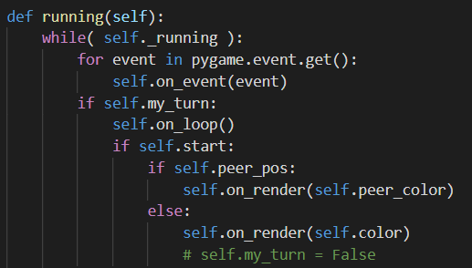
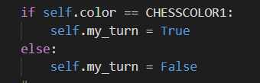
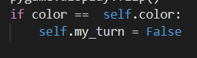
Explanation of approach
Main game design:
Played one move after another – Initialize the my_turn state, a Boolean switch

Slide 14
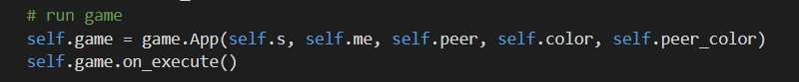
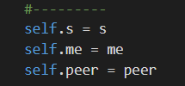
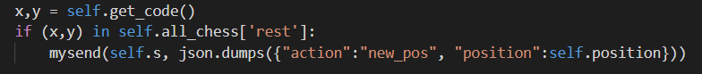
Explanation of approach
Main game design:
Synchronizing – Passes the socket of the user: self.s on initialization of the game
In __init__():
In on_loop() and on_event():

Slide 15
Live show case
A simple working demo of our code:

Slide 16
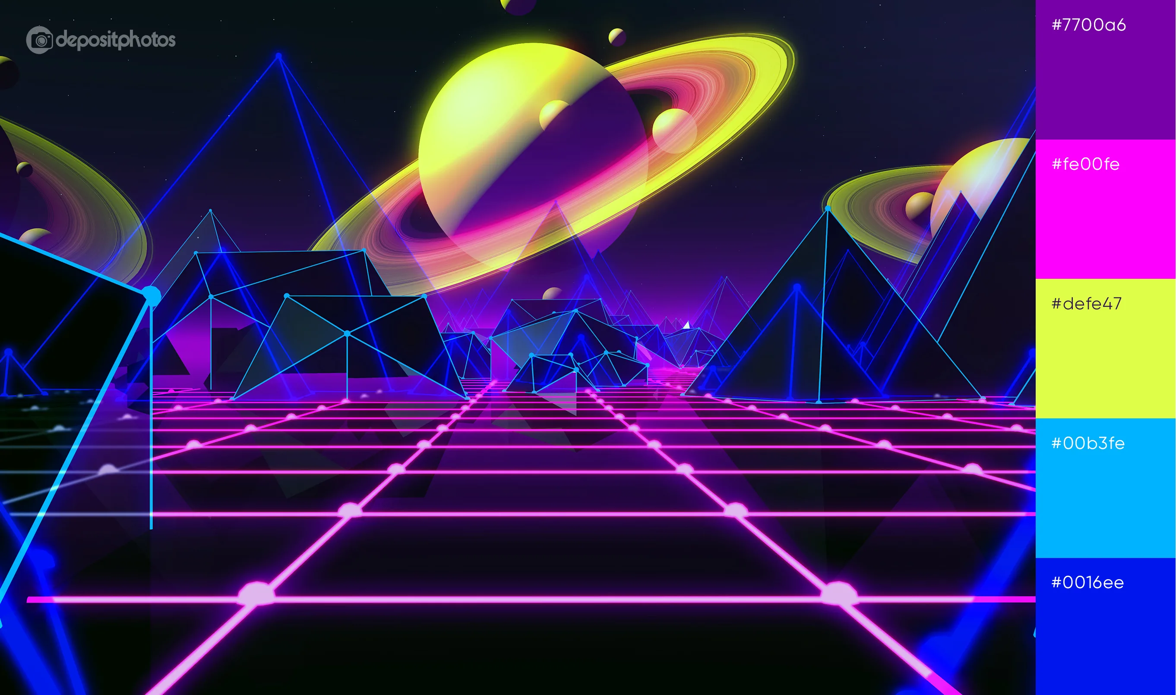
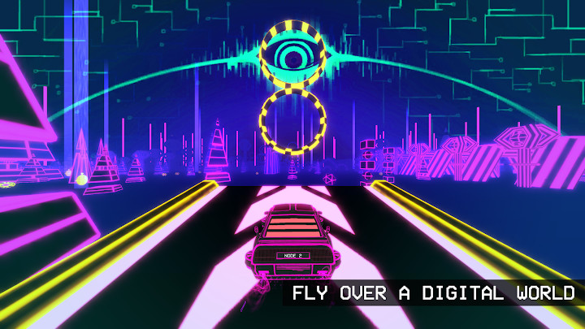
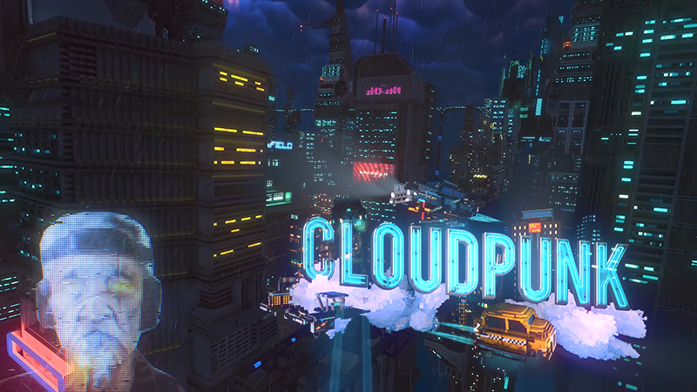
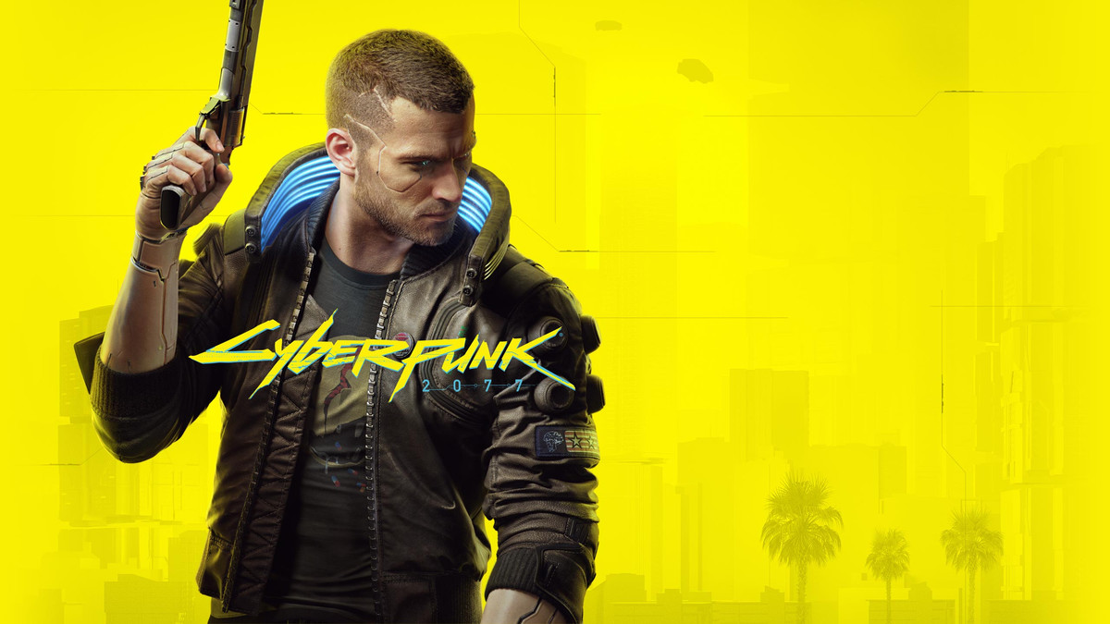
Visual Design
Color – Cyberpunk color palette
Cyberpunk 2077
==> Gobang 2077!

Slide 17
Comments & Possible Improvements
Good implementation of OOP & Threading
Issue with the multi-threading: myrecv() cannot be properly stopped ==> jamming the server
Add an AI to play with

Slide 18
Thanks for Watching!

